Slide 1
TEAM-10
WEATHER PICKER APPLICATION

Slide 2
TEAM
SAKSHAM JOSHI 500119066(TEAM LEAD)
RHYTHM GUPTA 500124221
MOHD. ANAS 500121888
AYUSH RAWAT 500121095

Slide 3
WEATHER PICKER APPLICATION
A weather picker application is a software tool that provides information about temperature and current weather conditions.

Slide 4
WORK BREAKDOWN STRUCTURE
Mohd. Anas : Python Code
Rhythm Gupta : API
Ayush Rawat : UI Design
Saksham Joshi : Error Debugging and Frontend

Slide 5


PROGRAMMING LANGUAGE AND TOOLS USED
Python for creating the application
Open Weather API to get weather data
Python frameworks like Tkinter etc. to design the UI and to call API.

Slide 6
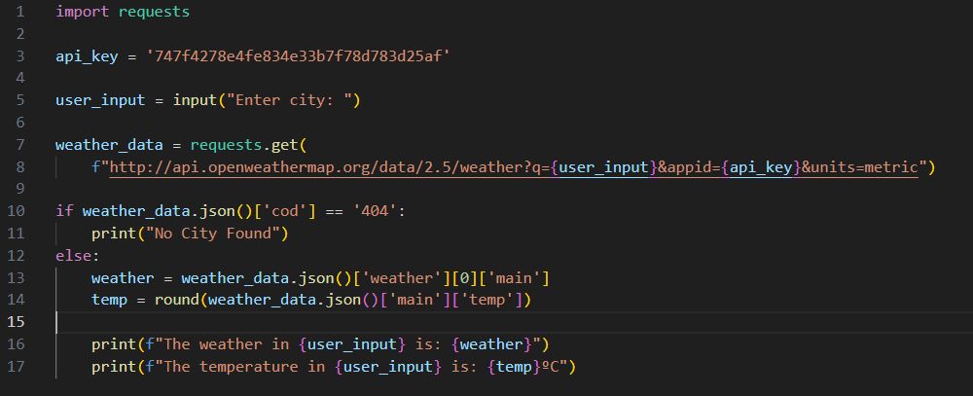

FIRST PROTOTYPE

Slide 7
THANK YOU

